Slide 1

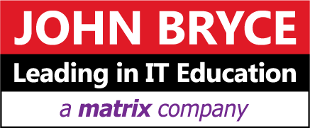
Ci with Docker

Slide 2
What is Docker?
Docker is an open-source project that automates the deployment of applications inside software containers, by providing an additional layer of abstraction and automation of operating system–level virtualization on Linux

Slide 3
What is Docker?
For this current course we have already created the Docker environment on Ubuntu for you, please ask mentor to provide the credentials.
- by this sign we would mark the practice part
Get to the course Docker environment using SSH CLI (command line interface):
Type the following command to get the docker and docker compose version:
>docker --version
The output should say like this:
Docker version 18.06.0-ce, build 0ffa825
>docker-compose --version
docker-compose version 1.21.0, build 5920eb0
By typing docker/docker-compose --help you could attain the usage page

Slide 4
What is Docker?
The Docker is designed to make it easier to create, deploy, and run applications by using containers.
Containers allow a developer to package up an application with all of the parts it needs, such as libraries and other dependencies, and ship it all out as one package. By doing so, thanks to the container, the developer can rest assured that the application will run on any other Linux machine regardless of any customized settings that machine might have that could differ from the machine used for writing and
testing the code.

Slide 5
What is Docker?

Slide 6
Run Platforms
The product line is currently divided on two editions:
DOCKER COMMUNITY EDITION (CE)
Docker CE is available for free and is ideal for developers and small teams looking to get started with Docker to build container apps. Docker CE offers a monthly or quarterly release cadence for both the adventurous and practical developer.
DOCKER ENTERPRISE EDITION (EE)
Docker EE is an enterprise-ready container platform delivered as a subscription of software, support and certification. As a complete platform solution, Docker EE includes a secure container runtime, choice of Swarm and Kubernetes orchestration, and a set of security, governance, and automation solutions for the end-to-end lifecycle management of containerized applications.

Slide 7
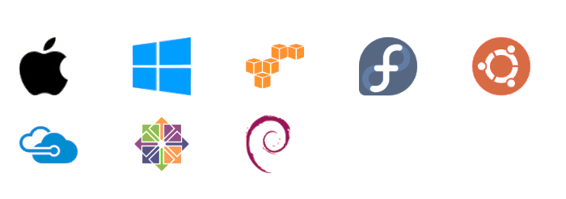
Run Platforms
Various Linux distributions (Ubuntu, Fedora, RHEL, Centos, openSUSE, ...)
Cloud(AmazonEC2, Google Compute Engine, Rackspace)
Windows10, 2016 with containers
MacOS
CE:
EE:

Slide 8
Common Use Cases for Docker
CI / CT/ CD
Fast Scaling application layers for overcoming application performance limitations.
For Sandboxed environments (Development, Testing , Debugging)
Local development environment ( no more “ It ran on my laptop…” )
Infrastructure as a CODE made easy with docker
Multi-Tier applications (Front End , Mid Tier (Biz Logic) , Data Tier) / Microservices
Building PaaS , Saas

Slide 9
Docker versus VMs
Containers are isolated, but
share OS and, where it is
appropriate, bins/libraries

Slide 10
Docker Benefits Upon VMs
Small to tiny images - Few hundred MB’s for OS + Application (5MB for full OS - Alpine) VS. Gigabytes in VM’s
Very small footprint on the host machine (CPU, RAM Impact) as Docker only use what it required instead of building a complete Operating system per VM.
Containers use up only as many system resources as they need at a given time. VMs usually require some resources to be permanently allocated before the virtual machine starts.
Direct hardware access. Applications running inside virtual machines generally cannot access hardware like graphics cards on the host in order to speed processing. Containers Can (ex. Nvidia )
Microservice in nature and integrations (API’s) for whatever task required.
Portable, Fast (Deployments , Migration , Restarts and Rollbacks) and Secure
Can run anywhere and everywhere
Simplify DevOps
Version controlled
Open Source

Slide 11
Docker’s Technology
libvirt: Platform Virtualization
LXC(LinuXContainers):Multiple isolated Linuxsystems(containers)
on a single host
libcontainer library (Since version 0.9,
Docker includes the libcontainer library
as its own way to directly use virtualization
Facilities provided by the Linux kernel)
Layered File System

Slide 12
Docker’s Technology
Architecture: Linux X86-64
Written in: GoLang (On March 13, 2014, with the release of version 0.9, Docker dropped LXC as the default execution environment which is an operating system level virtualization and replaced it with its own libcontainer library written in the Go programming language)
Engine: Client - Server (Daemon) Architecture
Namespace: Isolation of process in linux where one process cant “See” the other process
Control Groups: Linux Kernel capability to limit and isolate the resource usage (CPU, RAM, disk I/O, network etc..) of a collection of process
Container format: libcontainer - Go implementation for creating containers with namespaces, control groups and File system capabilities access control

Slide 13
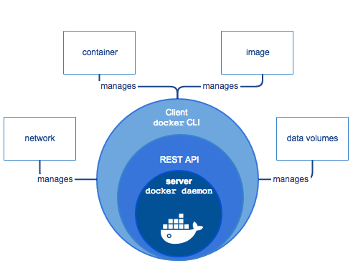
Docker Architecture

Slide 14
Docker - Technical Aspect
Docker uses a client-server architecture. The Docker client talks to the Docker daemon, which does the heavy lifting of building, running, and distributing your Docker containers. The Docker client and daemon can run on the same system, or you can connect a Docker client to a remote Docker daemon. The Docker client and daemon communicate using a REST API, over UNIX sockets or a network interface.

Slide 15
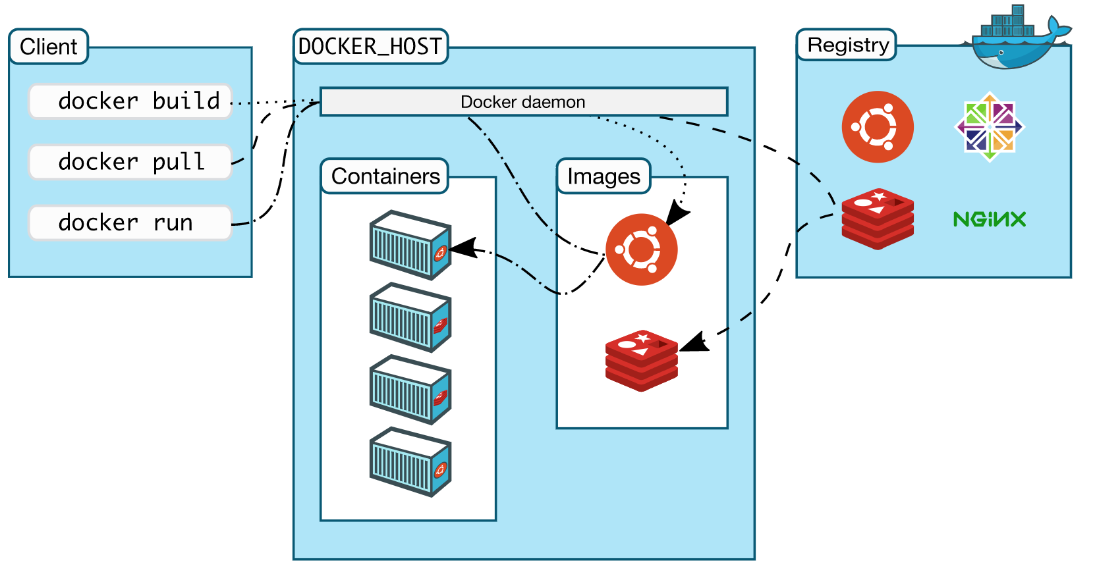
Docker Architecture

Slide 16
Docker Components
Engine
Daemon
(Docker) Client
Docker Registries
Docker Objects
Machine
Compose
Swarm/Kubernetes

Slide 17
Docker Components
Engine
A server which is a type of long-running program called a daemon process (the dockerd command).
A REST API which specifies interfaces that programs can use to talk to the daemon and instruct it what to do.
A command line interface (CLI) client (the docker command).

Slide 18
Docker LifeCycle (development & Operations)

Slide 19
Docker Operations
Some Useful commands to know:
- Docker ps: shows what is running - Docker pull: pulls a ”Docker Image“ into a container - Docker run: running a docker image
- Docker pause: pauses a container
Docker unpause: resin docker - Docker kill: killing a docker - Docker rm: removes the docker -

Slide 20
Docker LifeCycle (development & Operations)
Docker Container
Java Application

Slide 21
Docker Components
Daemon
The Docker daemon (dockerd) listens for Docker API requests and manages Docker objects such as images, containers, networks, and volumes. A daemon can also communicate with other daemons to manage Docker services.

Slide 22
Docker Components
Docker Client
The Docker client (docker) is the primary way that many Docker users interact with Docker. When you use commands such as docker run, the client sends these commands to dockerd, which carries them out. The docker command uses the Docker API. The Docker client can communicate with more than one daemon.

Slide 23
Docker Components
Docker Registries
A Docker registry stores Docker images. Docker Hub and Docker Cloud are public registries that anyone can use, and Docker is configured to look for images on Docker Hub by default. You can even run your own private registry.
When one use “docker pull / push / run” commands, the required images are pulled from the configured registry.

Slide 24
Docker Components
Docker Objects
Containers
A container is a runnable instance of an image. You can create, start, stop, move, or delete a container using the Docker API or CLI. You can connect a container to one or more networks, attach storage to it, or even create a new image based on its current state.
Container is defined by its image as a well as any configuration options we provide to it when created or when we start it

Slide 25
Docker containers
To get our first container please type the following command:
>docker pull ubuntu
Output:
…
Unable to find image 'ubuntu:latest' locally
latest: Pulling from library/ubuntu
…
Status: Downloaded newer image for ubuntu:latest
Now we have the ubuntu image downloaded. Please run the command to see it:
>docker images
REPOSITORY | TAG | IMAGE ID | CREATED | SIZE
Ubuntu | latest | <any ID> | 10 hours ago | 83.5MB

Slide 26
Docker containers
To run this image we need to type:
>docker run –it ubuntu bash
Output:
ubuntu@ip-172-31-44-83:~$ docker run -it ubuntu bash
root@381ad59e2004:/#
Now we are inside the ubuntu container, you could create the test directory there:
root@381ad59e2004:/# mkdir /test_dir_in_container
Open the additional SSH CLI session to the test environment and run (List containers):
>docker ps
CONTAINER ID | IMAGE | COMMAND | CREATED | STATUS | PORTS | NAMES
381ad59e2004 | ubuntu | “bash” | 5 minutes ago | Up 5 minutes |  | distracted_hermann

Slide 27
Docker containers
Exit the container by typing:
>root@381ad59e2004:/# exit
Check that on the origin file system we don’t have that ‘test_dir_in_container’ directory:
>ubuntu@ip-172-31-44-83:~$ ls –ltr /
This shows that the containers are isolated out of the original system

Slide 28
Docker Components
Services
Allow you to scale containers across multiple Docker daemons, which all work together as a swarm with multiple managers and workers. Each member of a swarm is a Docker daemon, and the daemons all communicate using the Docker API. A service allows you to define the desired state, such as the number of replicas of the service that must be available at any given time. By default, the service is load-balanced across all worker nodes. To the consumer, the Docker service appears to be a single application. Docker Engine supports swarm mode in Docker 1.12 and higher.

Slide 29
Dockerfile
In practically most cases, the CLI commands for the container creating would not cover the real needs of the DevOps, since we do have to pass more than only image name there. For the deeper parametrization the Dockerfile is being used.
Create images automatically using a build script: “Dockerfile”
Can be versioned in a version control system like Git or SVN, along with all dependencies
DockerHub can automatically build images based on docker files on Github

Slide 30
Dockerfile
To create a Dockerfile, please consider creating the directory:
>ubuntu@ip-172-31-44-83:~$ mkdir -p /home/ubuntu/docker_test
>ubuntu@ip-172-31-44-83:~$ vi /home/ubuntu/docker_test/Dockerfile
FROM ubuntu
ENV DOCK_MESSAGE 'Hello My World’
COPY . /test_dir_in_container/
>ubuntu@ip-172-31-44-83:~$ cd /home/ubuntu/docker_test
>ubuntu@ip-172-31-44-83:~$ docker build . –t ubuntu_out_of_dockerfile
>ubuntu@ip-172-31-44-83:~$ docker run -it ubuntu_out_of_dockerfile bash
root@2ebe80f3fd33:/# ls -ltr test_dir_in_container/
See the Dockerfile copied inside to the container from the main environment

Slide 31
Dockerfile
Run the command to check the environment variable we have passed:
root@2ebe80f3fd33:/# echo $DOCK_MESSAGE
Output:
Hello My World
To stop container, please type:
root@2ebe80f3fd33:/# exit
To delete the image:
>ubuntu@ip-172-31-44-83:~$ docker rmi ubuntu_out_of_dockerfile --force
rmi – remove image
--force – apply the force flag to avoid remove repository conflicts

Slide 32
Maintaining the connection
To test the publish port feature, please alter our Dockerfile:
FROM tomcat:8.0.20-jre8
>ubuntu@ip-172-31-44-83:~$ docker build . –t tomcat
>ubuntu@ip-172-31-44-83:~$ docker run -p 80:8080 tomcat
Go via a web browser to http://<YOUR_ENVIRONMENT_IP>:80, and see the Apache Tomcat admin page:
“Ctrl+c” to stop the container. Please delete the image.

Slide 33
Docker Hub
We got all the images for our examples (ubuntu, tomcat) out of the native docker public repository, called Docker Hub. To work with your own images you could create your account for free. We do need that account for our exercises in future, please consider creating.
https://hub.docker.com/

Slide 34
Docker Hub
Public repository of Docker images
https://hub.docker.com/
docker search[term]
Automated: Has been automatically built from Dockerfile
Source for build is available on GitHub

Slide 35
Jenkins and Docker
In the regards to the Jenkins integration, we could mention the following main cases:
The docker containers are used to provide the Jenkins with the additional executers during the job execution
The Dockerfile, stored within the code in GIT, is used for the specific container creation to run the unit tests during the CI
The Dockerfile, stored within the code in GIT, is used for the artifact creation on the PR to product branch. The images are pushed to the GITHub or other registries such as Nexus for the product distribution among the CD flow.
The best practice for the docker manipulations is to install the special extensions.

Slide 36
Jenkins and Docker: part of pipeline
Docker build step plugin allows to add various Docker commands into your job as a build step. Plugin currently support following commands:
commit changes in specified container
create new container from image
create image from Dockerfile
create exec command
kill container(s)
pull image from a repository
push image to a repository
remove container(s)
remove all containers
restart container(s)
start container(s)
stop container(s)
stop all containers
start/stop all containers created from specified image
start exec command

Slide 37
Jenkins and Docker: part of pipeline

Slide 38
Workflow

